Slide 1


School of Computing and Information Technology, Eastern International University (EIU) - Vietnam

Slide 2
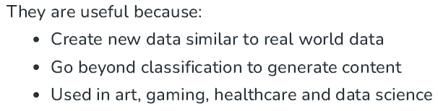
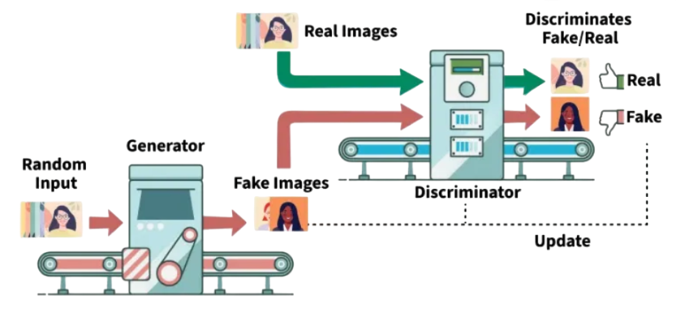
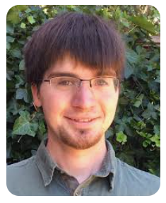
Ian J. Goodfellow is an American computer scientist, engineer, and executive, most noted for his work on AI and Deep Learning. He has made several important contributions to the field of deep learning, including the invention of the Generative Adversarial Network (GAN).
School of Computing and Information Technology, Eastern International University (EIU) - Vietnam

Slide 3

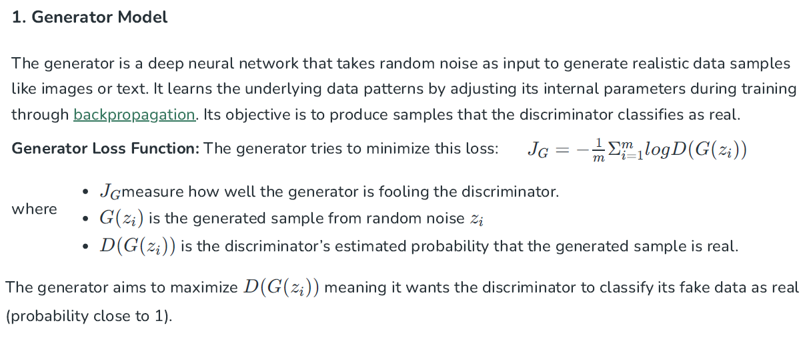

Slide 4
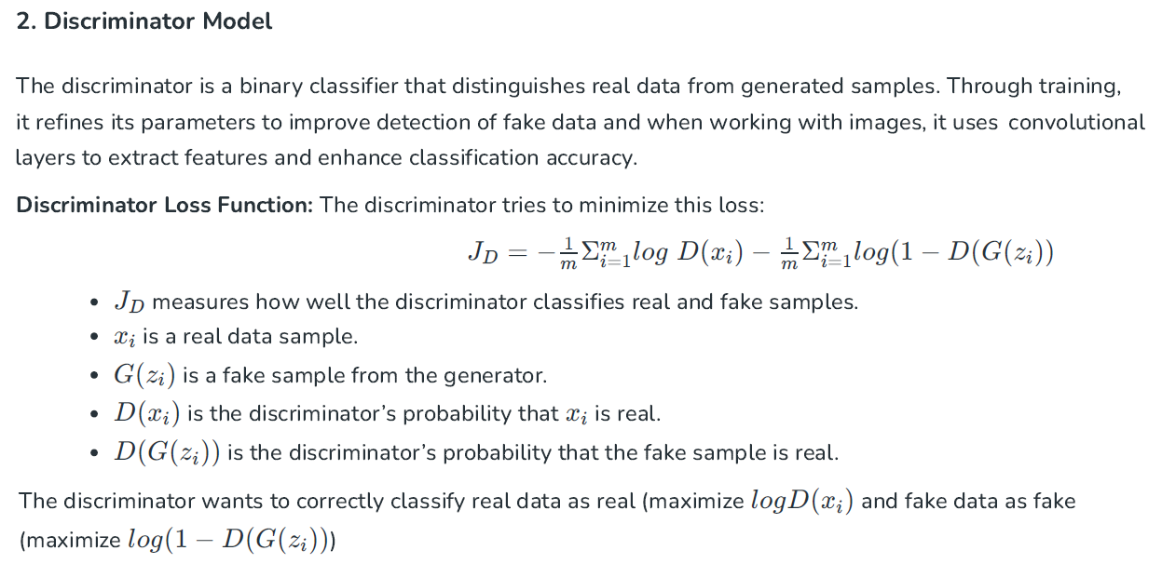
School of Computing and Information Technology, Eastern International University (EIU) - Vietnam

Slide 5

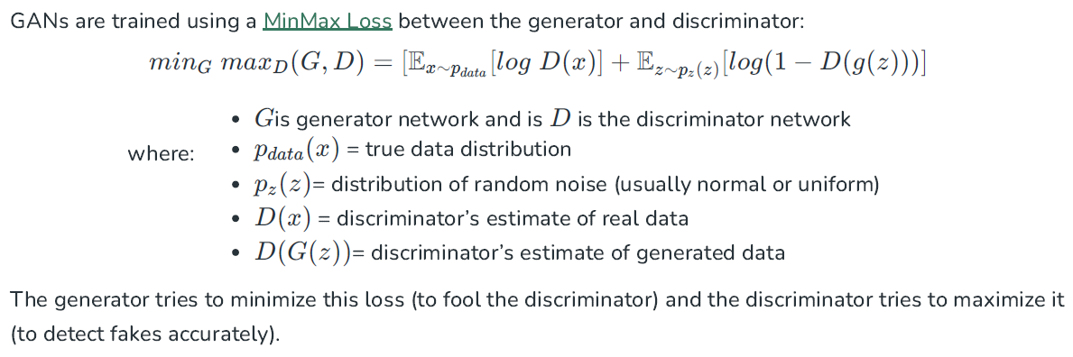
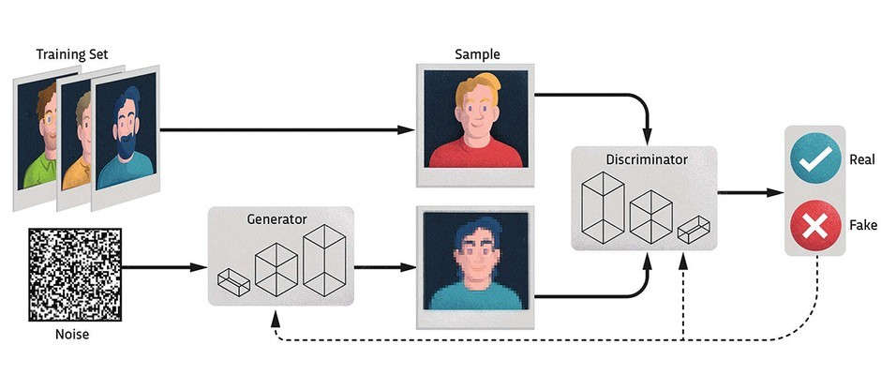

Slide 6

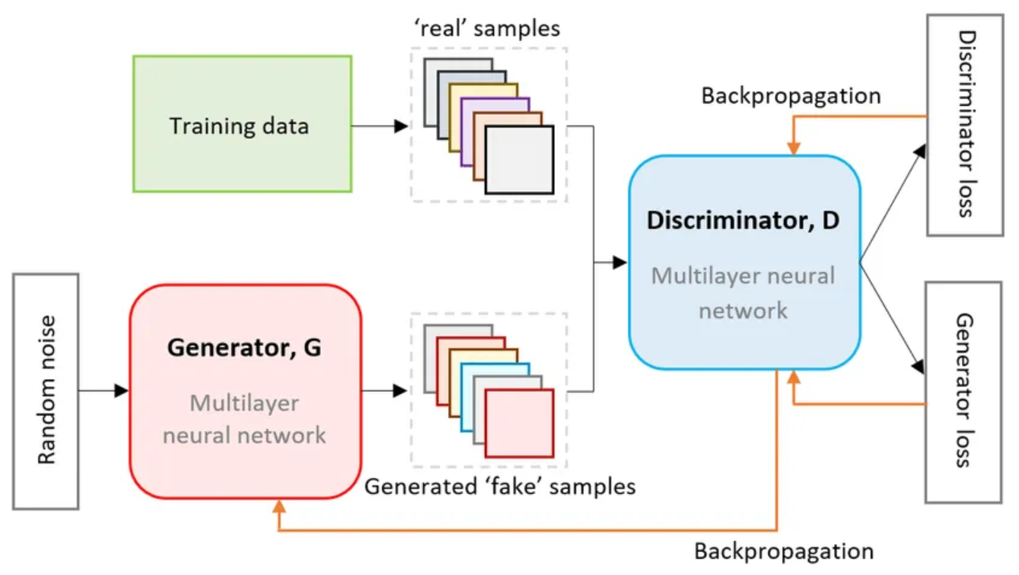

Slide 7
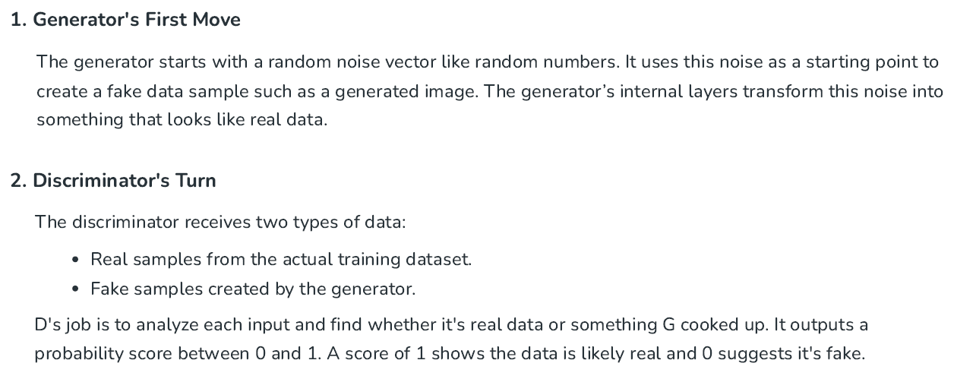
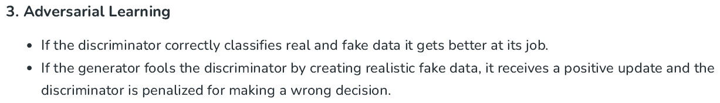

Slide 8
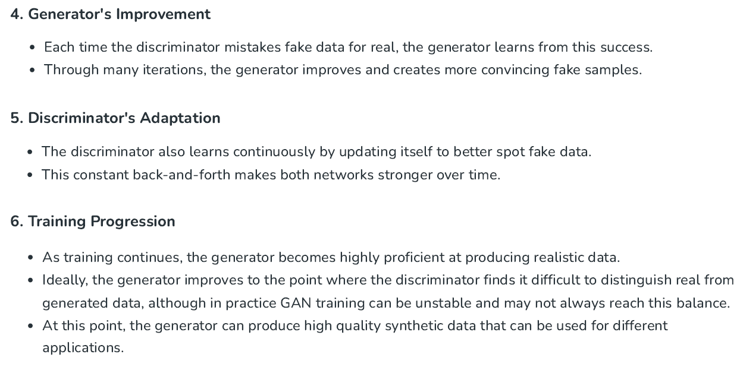
School of Computing and Information Technology, Eastern International University (EIU) - Vietnam

Slide 9

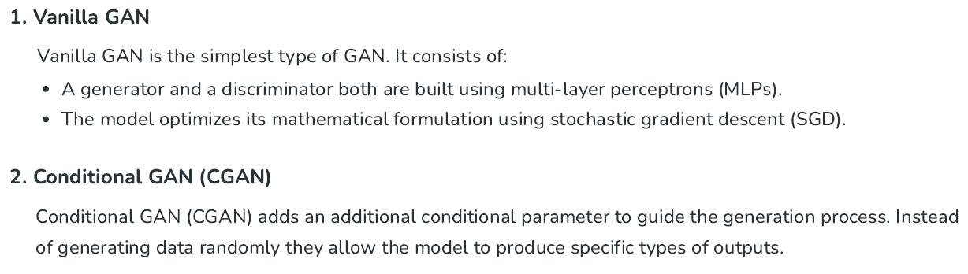
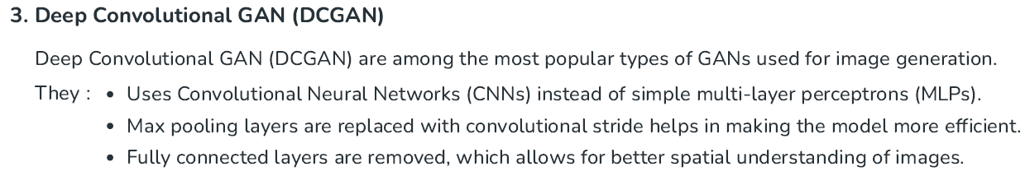

Slide 10
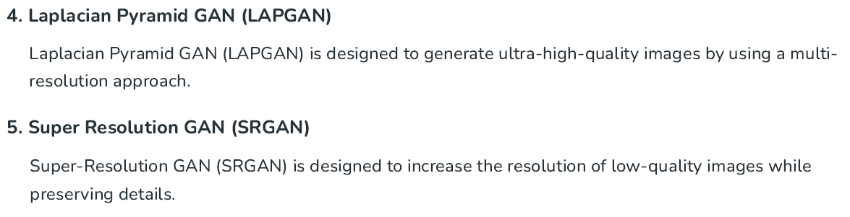

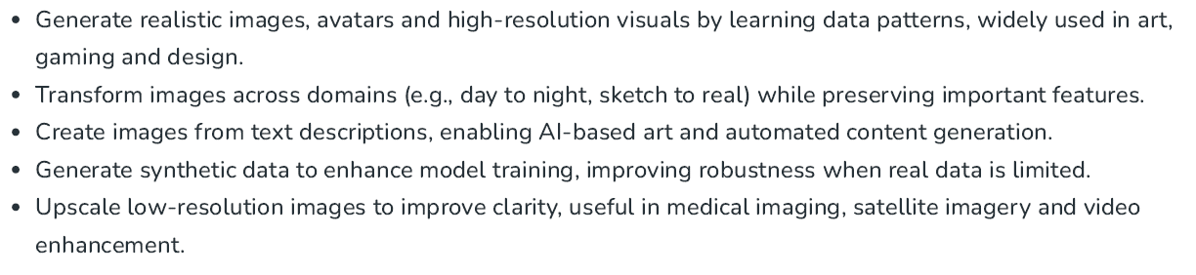

Slide 11

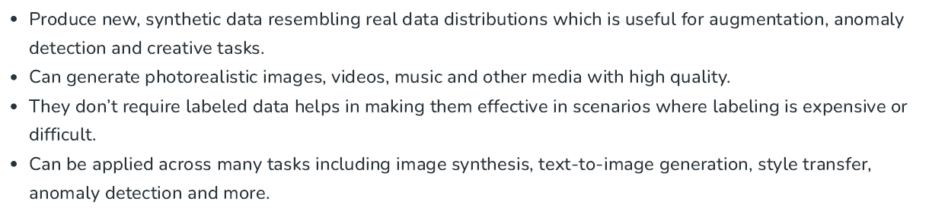
School of Computing and Information Technology, Eastern International University (EIU) - Vietnam

Slide 12
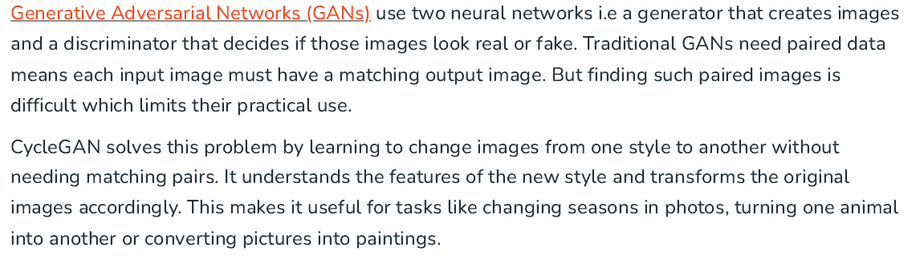
School of Computing and Information Technology, Eastern International University (EIU) - Vietnam

Slide 13
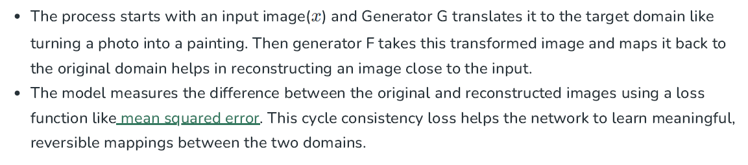
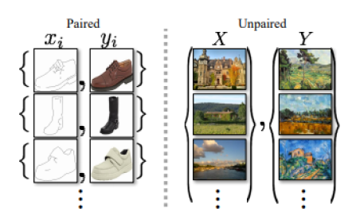
School of Computing and Information Technology, Eastern International University (EIU) - Vietnam

Slide 14

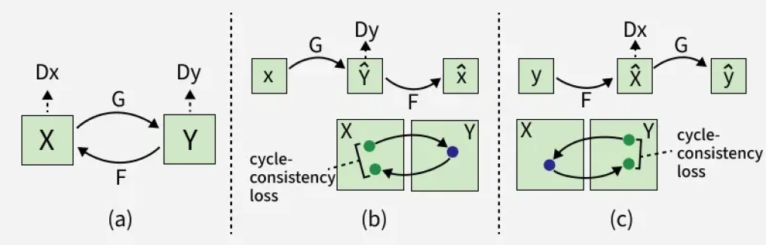
School of Computing and Information Technology, Eastern International University (EIU) - Vietnam

Slide 15
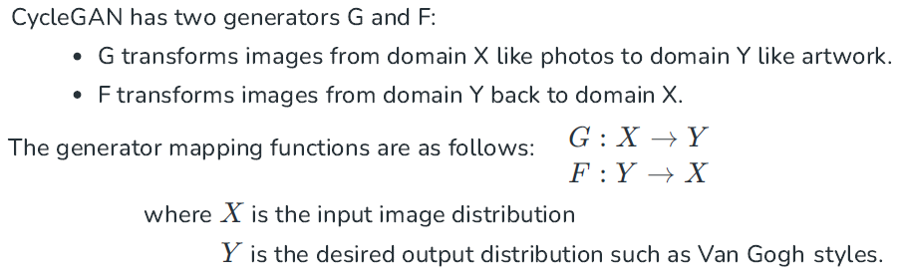
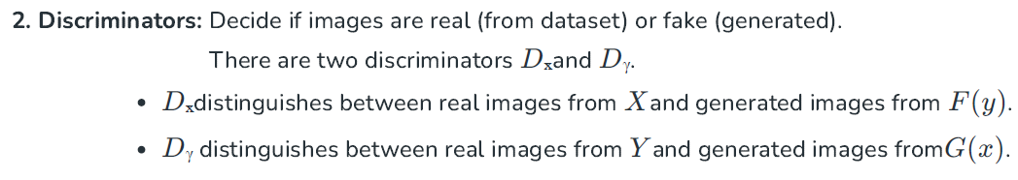
School of Computing and Information Technology, Eastern International University (EIU) - Vietnam

Slide 16
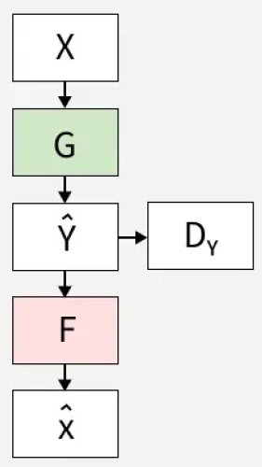
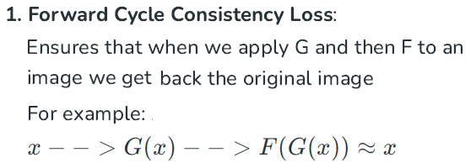
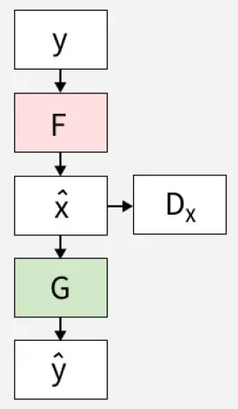
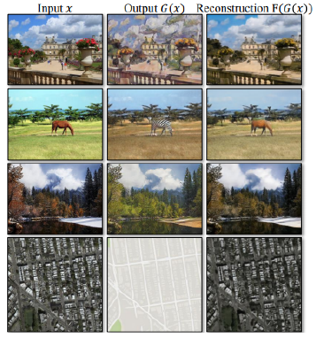
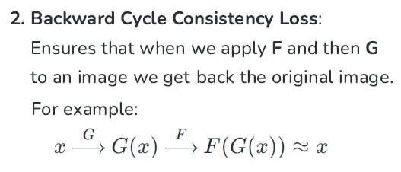
School of Computing and Information Technology, Eastern International University (EIU) - Vietnam

Slide 17

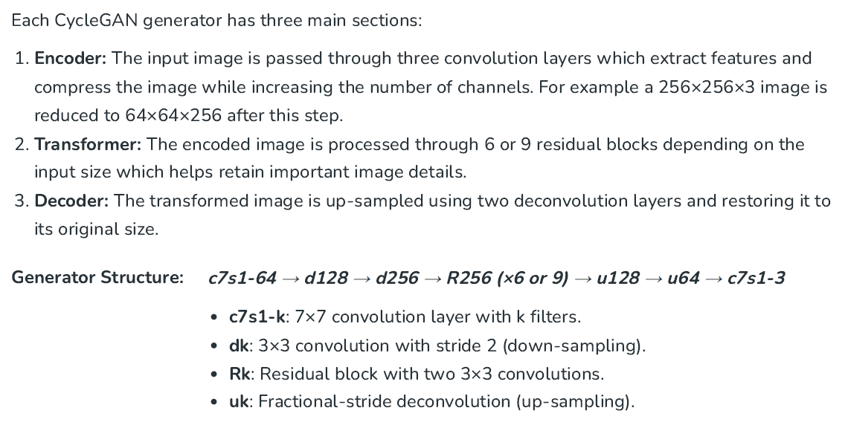
School of Computing and Information Technology, Eastern International University (EIU) - Vietnam

Slide 18
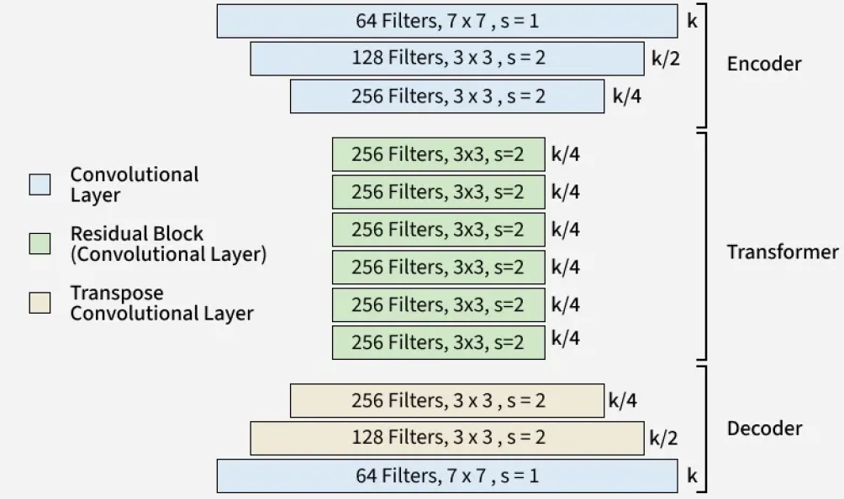
School of Computing and Information Technology, Eastern International University (EIU) - Vietnam

Slide 19
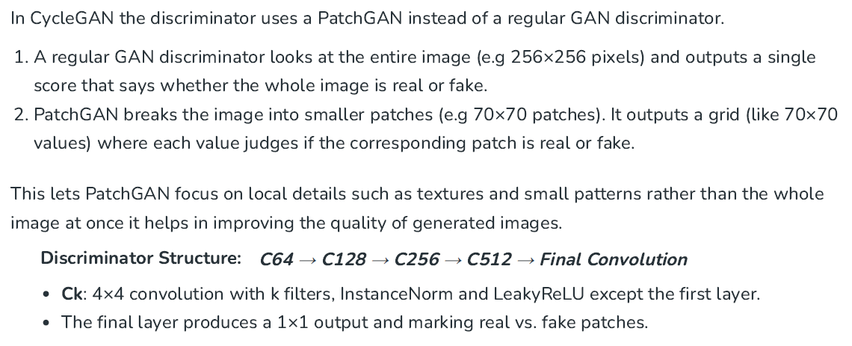
School of Computing and Information Technology, Eastern International University (EIU) - Vietnam

Slide 20
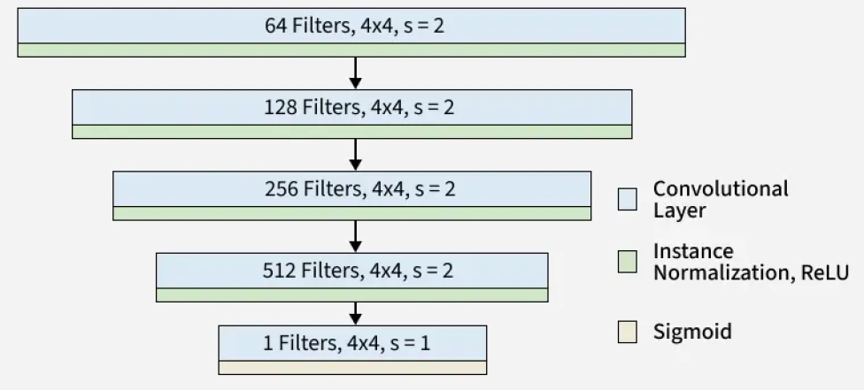
School of Computing and Information Technology, Eastern International University (EIU) - Vietnam

Slide 21

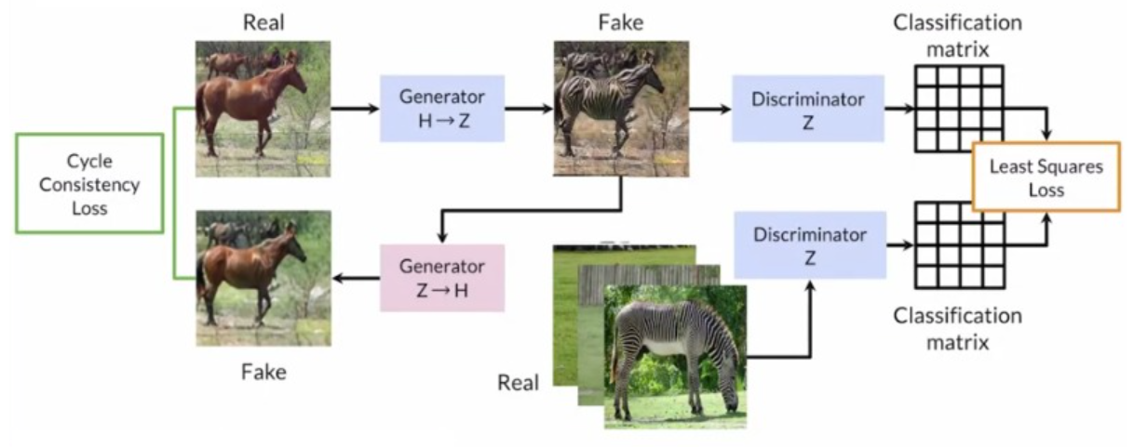
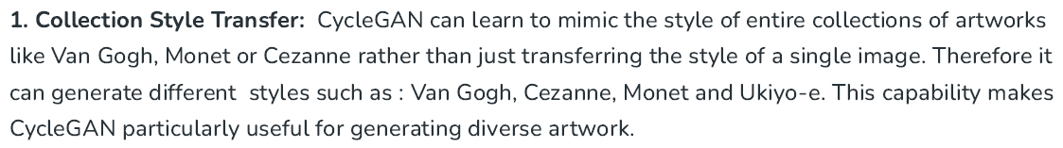
School of Computing and Information Technology, Eastern International University (EIU) - Vietnam

Slide 22
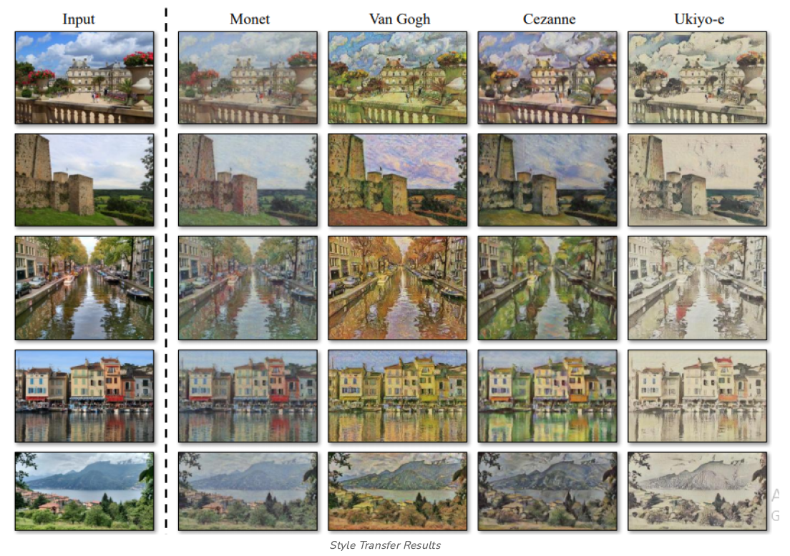

Slide 23
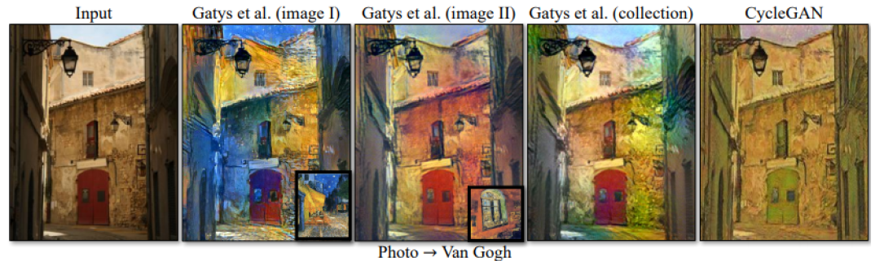
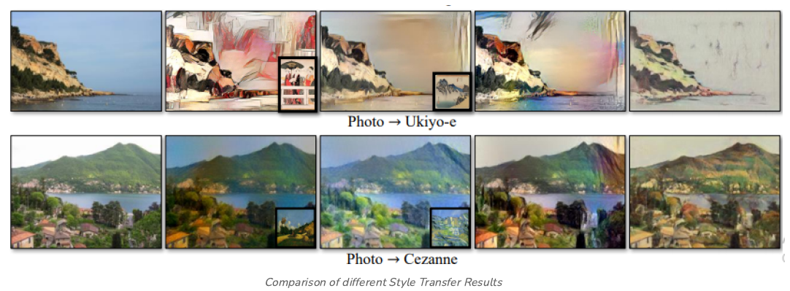

Slide 24
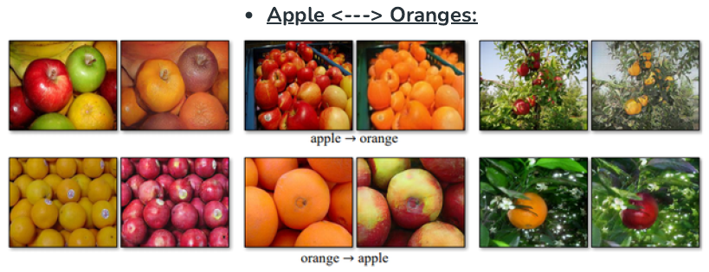
School of Computing and Information Technology, Eastern International University (EIU) - Vietnam

Slide 25
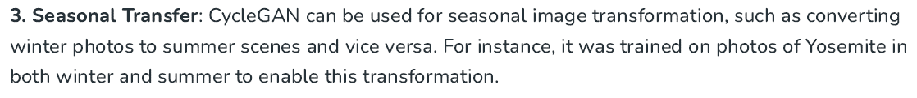
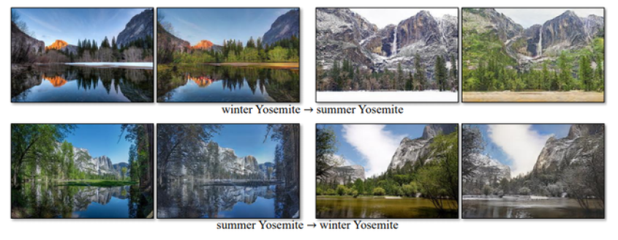
School of Computing and Information Technology, Eastern International University (EIU) - Vietnam

Slide 26
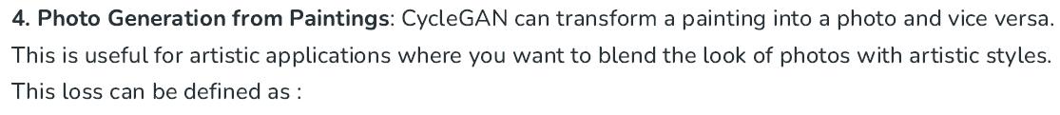
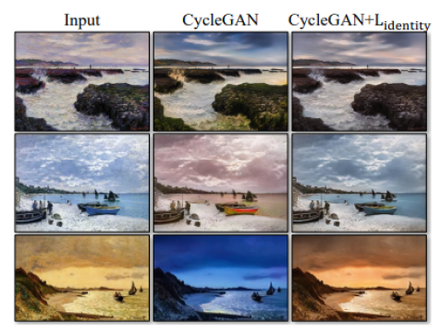


School of Computing and Information Technology, Eastern International University (EIU) - Vietnam

Slide 27
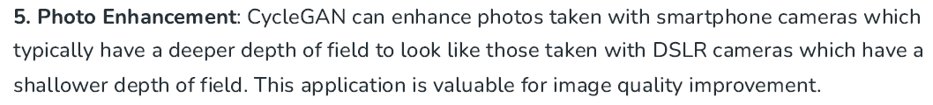
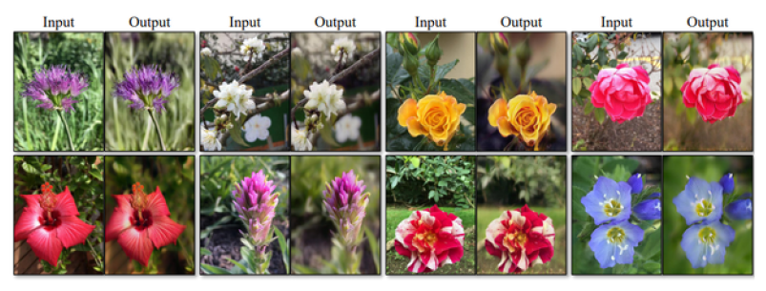
School of Computing and Information Technology, Eastern International University (EIU) - Vietnam

Slide 28
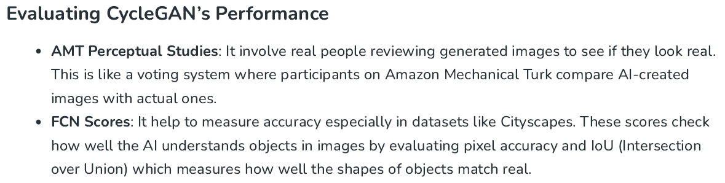
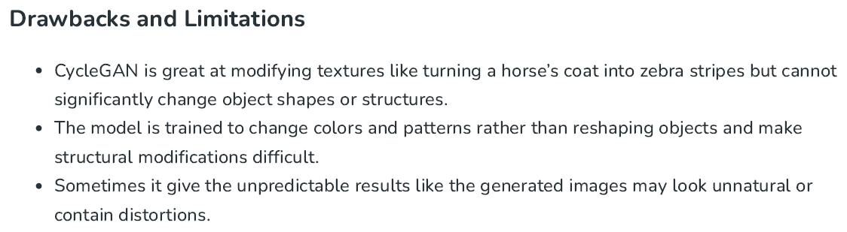

Slide 29
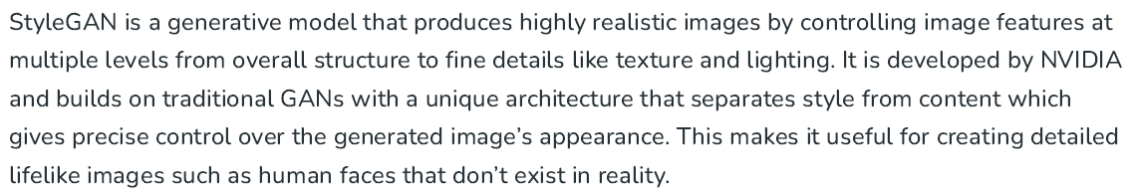

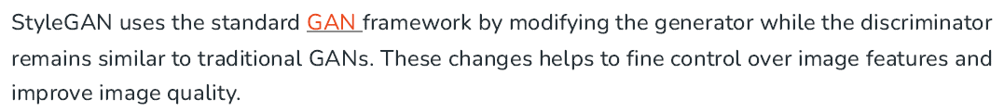
School of Computing and Information Technology, Eastern International University (EIU) - Vietnam

Slide 30
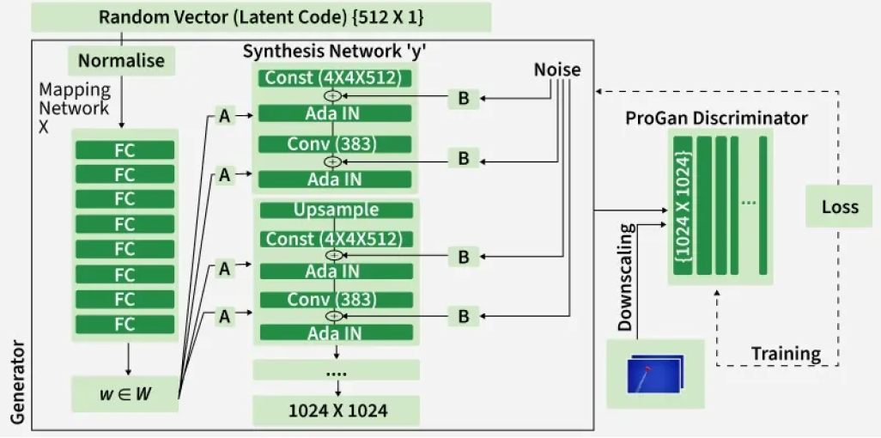


Slide 31
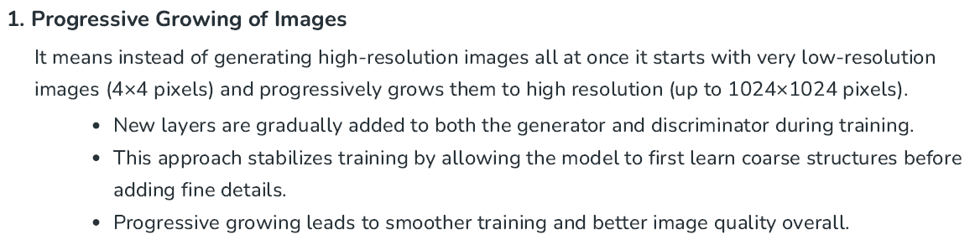
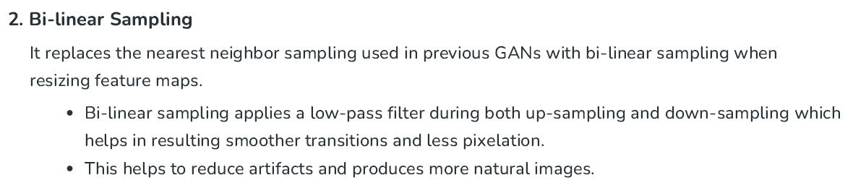
School of Computing and Information Technology, Eastern International University (EIU) - Vietnam

Slide 32

School of Computing and Information Technology, Eastern International University (EIU) - Vietnam

Slide 33


Slide 34



Slide 35

School of Computing and Information Technology, Eastern International University (EIU) - Vietnam

Slide 36





Slide 37

School of Computing and Information Technology, Eastern International University (EIU) - Vietnam

Slide 38



Slide 39


School of Computing and Information Technology, Eastern International University (EIU) - Vietnam

